Slide 1
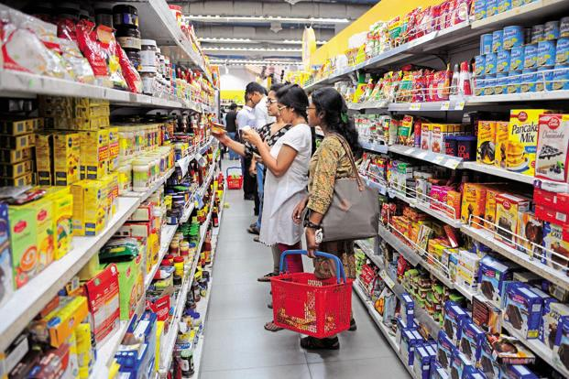
LOCATION RECOMENDER FOR RETAIL CHAINS

Slide 2
PROBLEM STATEMENT
This project involves making a recommender system for big retail chains such as Walmart, Target to find the best locations to open their outlets.
We need to get the coordinates of different neighborhoods using the Foursquare API to get the venues information in that neighborhood which would facilitate the retail chains to identify the best potential customers and decide whether opening a store in that neighborhood would be profitable or not.

Slide 3
DATA PREPARATION
The data would be obtained from Wikipedia table which contains the neighborhood and borough information.
Geopy module would be used to get the latitude and longitude information of each neighborhood.
The final data frame would be made by appending the latitude and longitude columns to the original data frame.

Slide 4
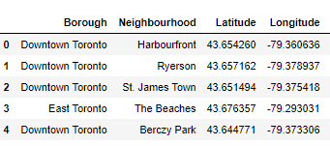
DATAFRAME

Slide 5
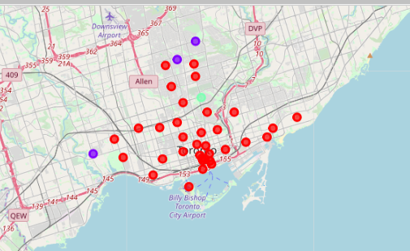
FINAL CLUSTERS USING FOURSQUARE API

Slide 6
OBSERVATION
The first cluster contains the most ideal neighborhood for the retail stores to open their outlets as there are many potential customers .
The last cluster contains one neighborhood which is not a good choice when it comes to opening an outlet.

Slide 7
conclusion
This Projects serves as a very good recommender tool for big retail chains to make a decision whether to open their outlets at a given or specified location . The foursquare API helps to get the most common venues at a location and machine learning help us to cluster these venues depending upon their similarity .Analysis of these clusters would help the retail chains to identify the potential customers and make a decision of opening their outlet stores.

Slide 8
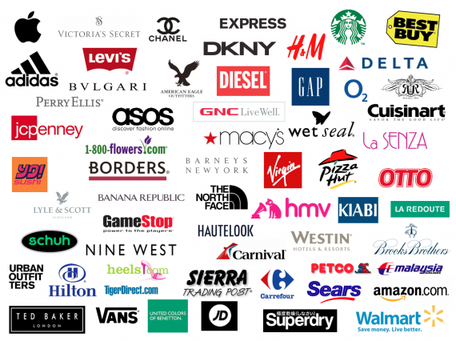
Thankyou !!!!

